Slide 1
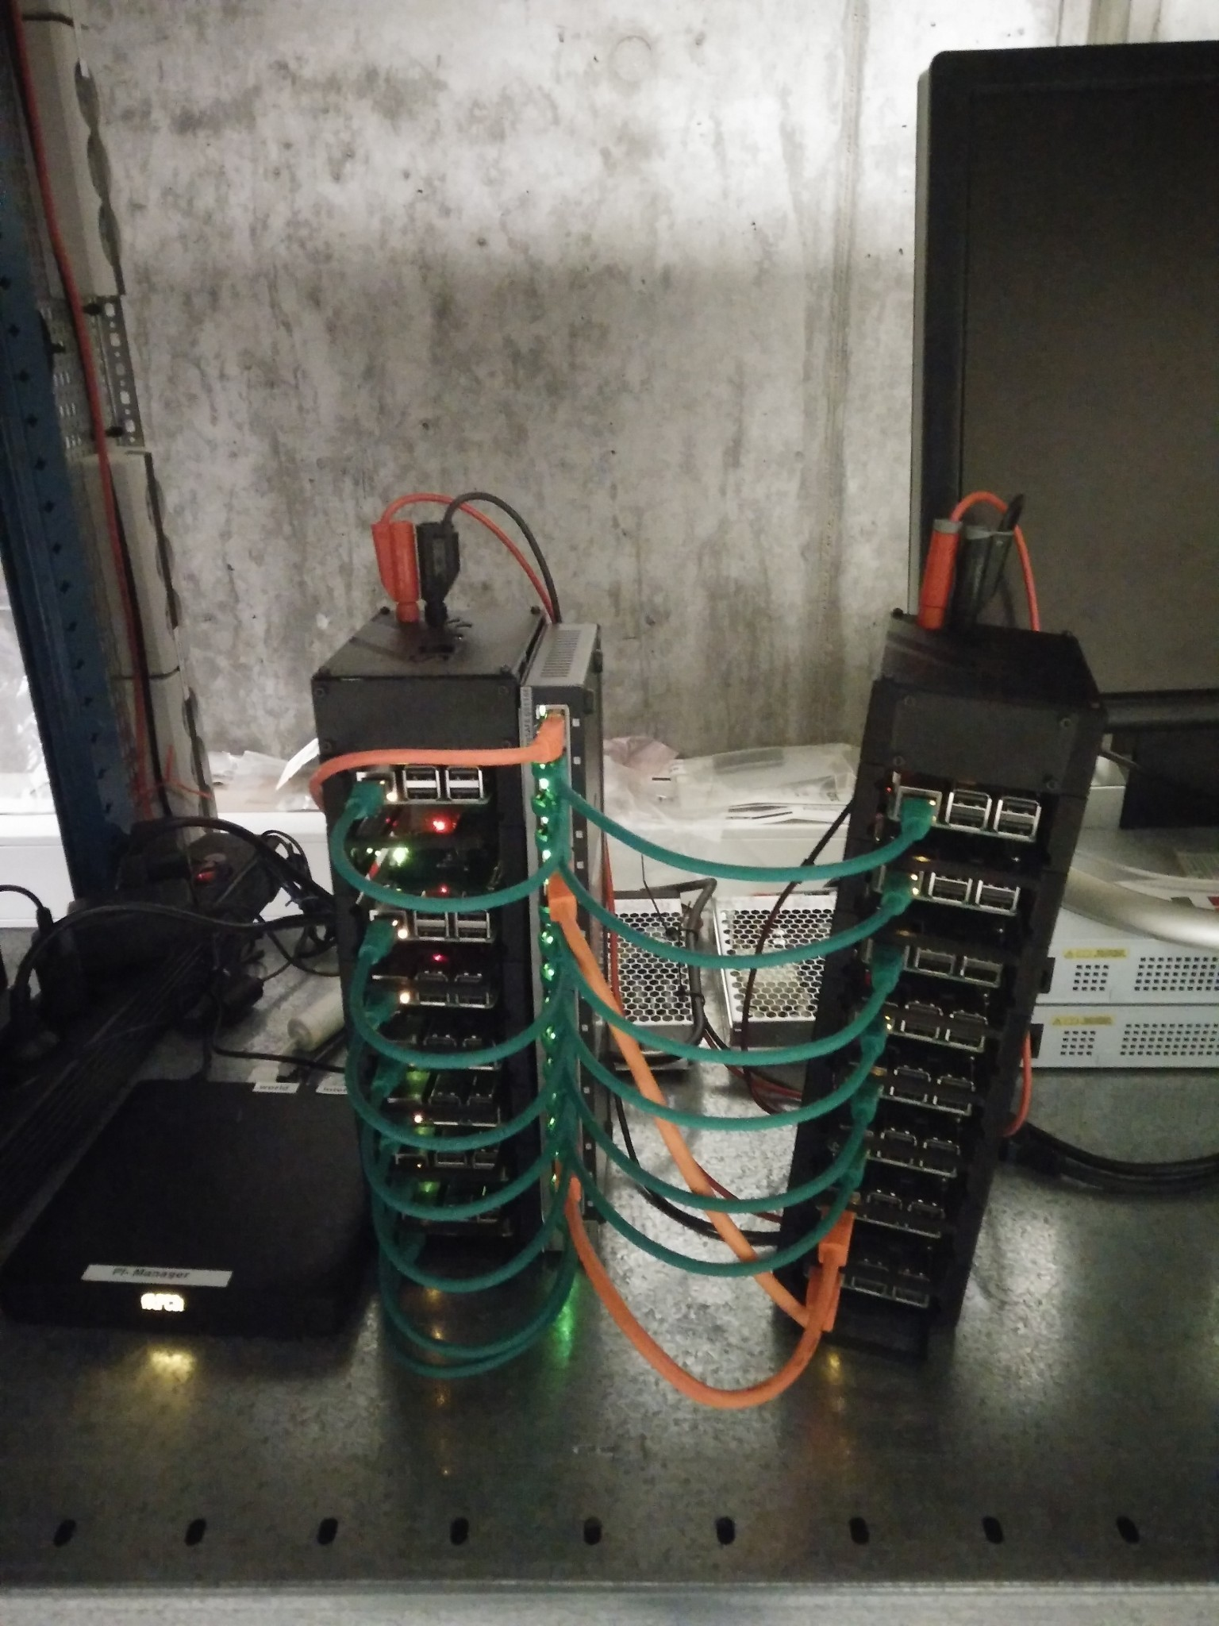

Slide 2
Cryptography 1
Made by John Hallam & Mathias Neerup

Slide 3
Agenda
Encryption
Digest
Ciphers
Signing
Wireshark
SSL/TLS
Motivation
Hashing
Authentication
Certificates
Protocols
MITM Proxy

Slide 4
Motivation (Exercise 1/3)
Open wireshark
filter “http”
Visit http://www.bbc.com
Find packet containing “GET / HTTP/1.1”
Start new capture
Filter “https”
Visit https://esrl.dk
Find packet containing “GET / HTTP/1.1”

Slide 5
Motivation
The connection is private
Eavesdroppers
The connection is reliable (integrity)
Tampering
MAC (message authentication code)
HMAC (Hash-based Message Authentication Code)
Identity of the communicating parties can be authenticated
MITM

Slide 6
SSL/TLS cons
Latency
Handshake
Complexity
Protocol - no ciphers!

Slide 7
SSL(depricated)/TLS - protocol
1995: SSL v2 was the first public release of SSL by Netscape.
1996: SSL v3 was a new version that fixed several security design flaws of SSL v2. By 2004, v3 was considered insecure due to the POODLE attack.
1999: TLS v1.0 was released with an SSL fallback mechanism for backwards-compatibility.
2006: TLS v1.1
2008: TLS v1.2 is the current TLS standard and is used in most cases.
TLS v1.3 is currently still only a working draft specification.
https://www.hostingadvice.com/how-to/tls-vs-ssl/

Slide 8
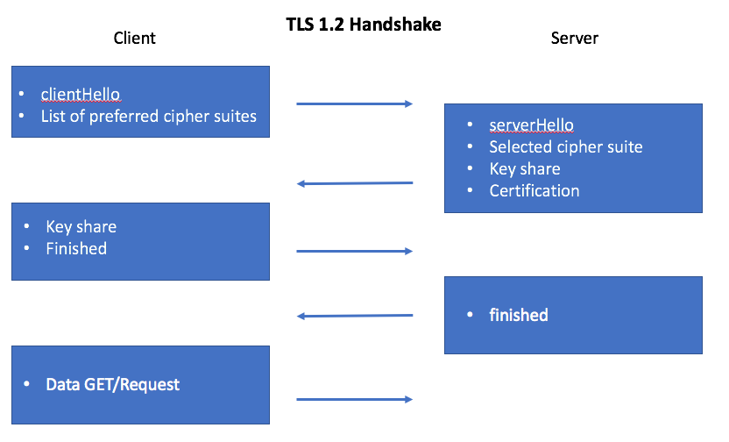
TLS - 1.2

Slide 9
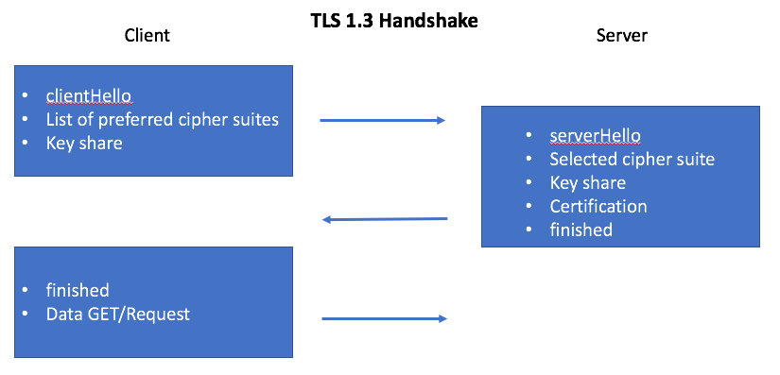
TLS - 1.3

Slide 10
SSL/TLS
TLS handshake layer
Authentication
Key exchange
TLS record layer
Encryption
Transmission

Slide 11
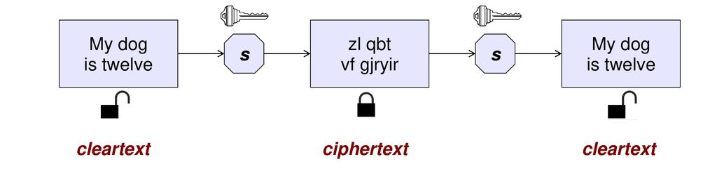
Encryption

Slide 12
Encryption
Bruteforce
Key exchange

Slide 13
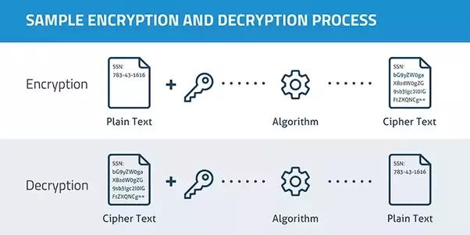
Encryption

Slide 14
Encryption
Algorithm = cipher

Slide 15
Encryption - Caesar cipher
Left shift 3
D => A
E => B
Plain: ABCDEFGHIJKLMNOPQRSTUVWXYZ Cipher: XYZABCDEFGHIJKLMNOPQRSTUVW

Slide 16
Encryption - Caesar cipher
Left shift 3
D => A
E => B
Plain: ABCDEFGHIJKLMNOPQRSTUVWXYZ Cipher: XYZABCDEFGHIJKLMNOPQRSTUVW
Attacker:
Knows or can guess word
Distribution of letters

Slide 17
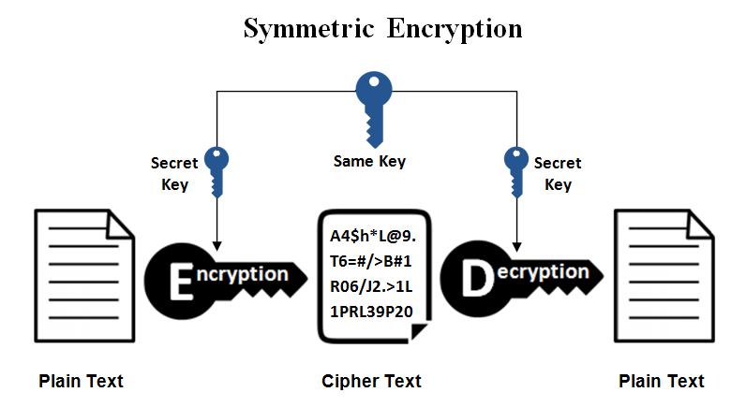
Encryption
Symmetric
Private/shared key algorithms
DES
3DES
AES

Slide 18
Exercise 2/3
Install “gpg” on your PC & on your RPIIXX
Create a file with cleartext and encrypt it on RPIIXX
gpg --output ciphertext.gpg --passphrase SomeSecretKey --symmetric cleartext
Scp the ciphertext to your PC
Decrypt the message on your PC and see cleartext again
gpg --decrypt ciphertext.gpg

Slide 19
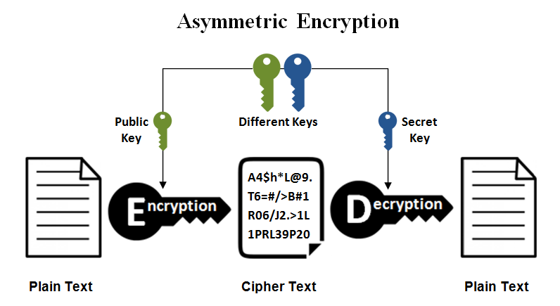
Encryption
Symmetric
private/shared key algorithms
Asymmetric
public/private key algorithms
RSA
Expensive...

Slide 20
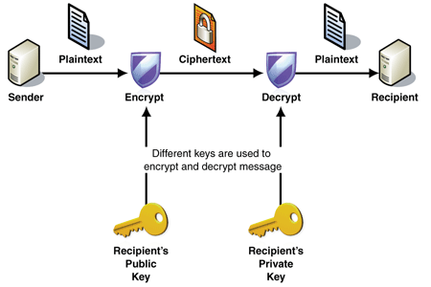
Asymetric key exchange

Slide 21
Exercise 3/3
Generate asymmetric keypair on your PC
gpg --gen-key
Export public key and save as mykey.pub on your PC
gpg --armor --export <email you used>
Scp the public key to your RPIIXX
Import public key on RPIIXX
gpg --import mykey.pub
Encrypt file using the public key on RPII
gpg --encrypt --recipient <email you used> text.txt
Scp text.txt.gpg (contains the ciphertext) to your PC
Decrypt using the private key
gpg --decrypt cleartext.txt.gpg
(share public key over GPG keyserver)

